Slide 1
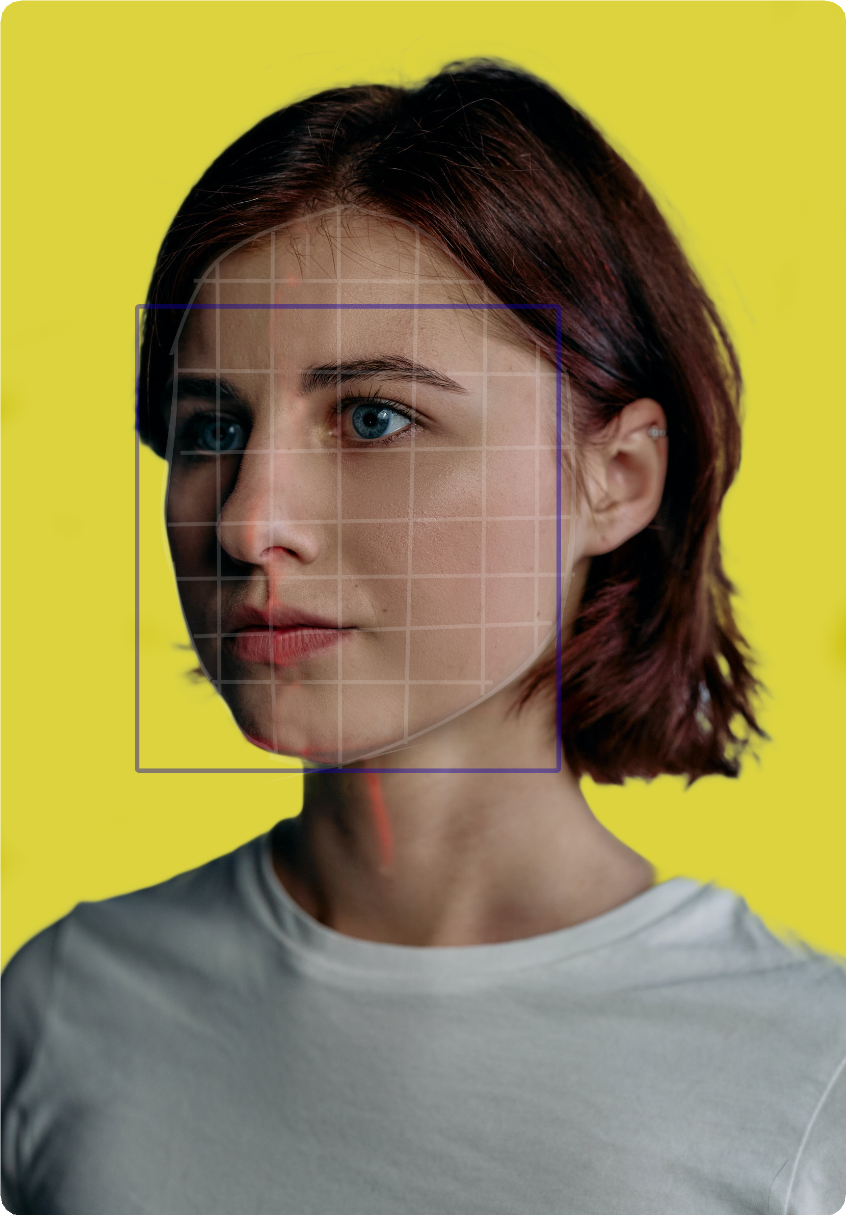
ATTENDANCE WITH
FACE RECOGNITION
M
P R O J E C T
01
Using Machine learning

Slide 2
i
A T T E N D A N C E
S Y S T E M
02
Table of Contents
Face recognition System
Introduction Scope Requirements
System Architecture Flowchart Designing of System Demo

Slide 3
Project
n
P R O J E C T B R I E F
Introduction
03
Face Recognition is a biometric method of identifying an individual by comparing live capture of digital image with the stored record for that person.
Face Recognition Attendance System is marking of attendance based on face_recognition technology

Slide 4
Why
Face Recognition ?
i
04
Manual time tracking solutions are very time consuming process.
Stressful , in-effective and hard to maintain manual records. Risk of human error.
Time theft.

Slide 5
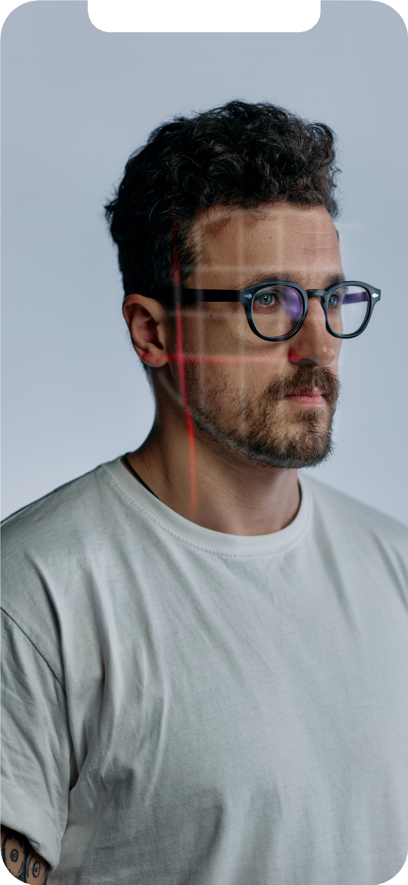
p
S O C I A L M E D I A R E P O R T
A face recognition system is built for matching human faces with a digital image and provides an automated attendance system.
What It Does?
05
In Facial recognition there are two types of comparisons - Face Detection and Face recognition
General performance

Slide 6


Face Detection
r
This refers to computer technology that is able to identifying human faces in digital images, video frames or video source.
06
Face Recognition
A facial recognition system technology capable of matching a human face from a image or a video frame.
Name

Slide 7
Face recognition - Advantages.
o
07
Automated Time Tracking System
Prevent data loss. Cost-Effective Easy To Manage
More Accurate and Better Attendance

Slide 8






j
NUMPY
Pandas
dlib
OpenCV
08
Library used for working with arrays
It is used for data manipulation and analysis.
Toolkit for making real world machine learning
A library used for computer vision.
Required
Libraries
face_recognition
Python OS module
Presentations are communication tools.
Presentations are communication tools.

Slide 9
System Requirements
e
F A C E R E C O G N I T I O N
09
Minimum Specification
Software
Pentium processor 256-1024 MB RAM
available space of 200MB Web Cam
Python - version =< 3.0
Visual studio code / Jupyter Notebook

Slide 10
System Architecture
c
Take snapshot
Face Detection
Gray scale
image
Register System
Person
10
Attendance
Admin
Record attendance
Image Data
Face Recognition
Generate Report

Slide 11
Brief of
System Architecture
t
The build of architecture is designed in such a way
that
11
a person can use this system with ease. At very first step a image of person should contain in the image data to recognize the person while being scanned. The system takes a snapshot and converts the image into gray scale image and detects the face in that snapshot, and encodes the image and compares the encodings with stored encodings of image data. If any matches found in image data , system will records the member's name and time . Final step , the recorded data will be stored in an excel sheet.
F A C E
R E C O G N I T I O N

Slide 12

FlowChart
d
Start
Images stored in image data
12
Recognition process starts
Camera captures the user image
Checks continously
Compare with image data
Doesn't match
Matches
Records as unknown person
Records the attendance
Stores the record
Stop

Slide 13
Steps of program build
d
Sign Up
Loading of image data
Importing of libraries program needed
13
It is nothing but adding a image into image data to recognize the person.
Stored images of registered members
OpenCV, numpy , face_recognition , OS
Converting to RGB2BGR /face detection/ Encoding
Marking attendance and storing
Comparing live image with images in image data
If match found attendance will be recorded and stored.
Three main steps to do
Repeating step four for live or snapshotted image and comparing their encodings .

Slide 14
Member Registration
d
14
Member
Sign Up
Admin
Admin Activity
Registered members

Slide 15
Importing Libraries
d
Opencv face_recognition
os numpy
15
import cv2
import face_recognition import os
import numpy as np
from datetime import datetime

Slide 16
Loading Image-Data
r
path = 'ImageData' images = [] classnames = []
mylist = os.listdir(path)
16
for i in mylist:
curimg = cv2.imread(f'{path}/{i}') images.append(curimg) classnames.append(os.path.splitext(i)[0])

Slide 17
Encoding Images in image-Data
e
17
def findEncoding(images): encodeList = []
for img in images:
img = cv2.cvtColor(img, cv2.COLOR_BGR2RGB) encode = face_recognition.face_encodings(img)[0] encodeList.append(encode)
return encodeList

Slide 18
Capturing live image and encoding
v
18
while True:
check, img = cap.read()
imge = cv2.resize(img, (0, 0), None, 0.25, 0.25) imge = cv2.cvtColor(imge, cv2.COLOR_BGR2RGB)
faceCur = face_recognition.face_locations(imge)
encd = face_recognition.face_encodings(imge, faceCur)

Slide 19
Comparing of Images
u
19
for encodeface, facloc in zip(encd, faceCur):
matches = face_recognition.compare_faces(encodeListknown, encodeface) facedis = face_recognition.face_distance(encodeListknown, encodeface) matchIndex = np.argmin(facedis)
if matches[matchIndex]:
name = classnames[matchIndex].upper() print(name)
y1, x2, y2, x1 = facloc
y1, x2, y2, x1 = y1 * 4, x2 * 4, y1 * 4, x1 * 4 cv2.rectangle(img, (x1, y1), (x2, y2), (0, 255, 0),
cv2.rectangle(img, (x1, y2 - 35), (x2, y2), (0, 255, 0), cv2.FILLED)
cv2.putText(img, name, (x1 + 6, y2 - 6), cv2.FONT_HERSHEY_COMPLEX,1, (255, 255, 255), 2)

Slide 20
Recording of
attendance and storing data
s
20
def Attendance(name):
with open('Attendance_Register.csv','r+') as f: DataList = f.readlines()
names = []
for data in DataList: ent = data.split(',') names.append(ent[0])
if name not in names: curr = datetime.now()
dt = curr.strftime('%H:%M:%S') f.writelines(f'\n{name},{dt}')
encodeKnown = DbEncodings(images)

Slide 21
Sample example for how it works
s
import cv2
import face_recognition import numpy as np
img1 = face_recognition.load_image_file('ImagesAttendance/ae.jpg') img1 = cv2.cvtColor(img1, cv2.COLOR_BGR2RGB)
facloc = face_recognition.face_locations(img1)[0] encodefac = face_recognition.face_encodings(img1)[0]
cv2.rectangle(img1, (facloc[3], facloc[0]), (facloc[1], facloc[2]), (0, 255, 0), 3)
21
img2 = face_recognition.load_image_file('ImagesAttendance/tst.png') img2 = cv2.cvtColor(img2, cv2.COLOR_BGR2RGB)
facloc1 = face_recognition.face_locations(img2)[0] encodefac1 = face_recognition.face_encodings(img2)[0]
cv2.rectangle(img2, (facloc1[3], facloc1[0]), (facloc1[1], facloc1[2]), (0, 255, 0), 3)
result = face_recognition.compare_faces([encodefac], encodefac1) facedis = face_recognition.face_distance([encodefac], encodefac1)
print(result, facedis)
cv2.putText(img2, f'{result} {round(facedis[0], 1)}', (50, 50), cv2.FONT_HERSHEY_COMPLEX, 1, (0, 255, 0), 1) cv2.imshow("main", img1)
cv2.imshow("main1", img2) cv2.waitKey(0)

Slide 22
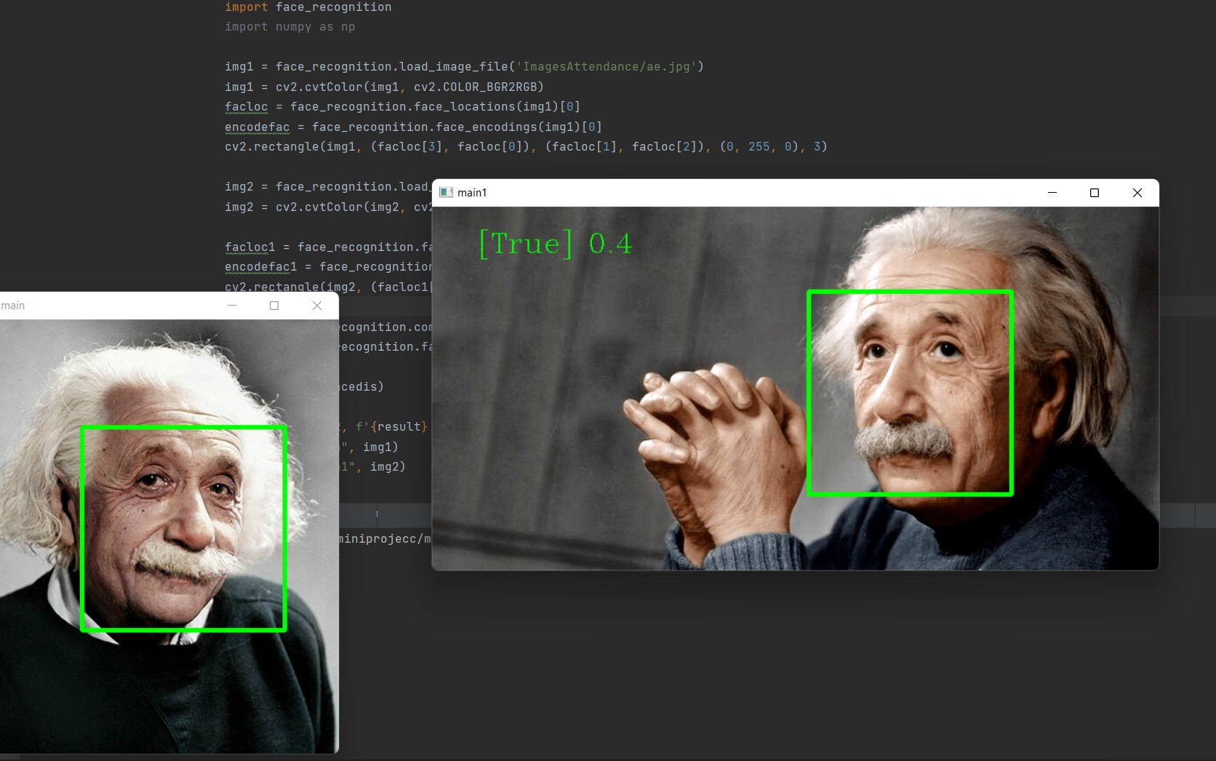
Output for the example
The program gave the output for given images and compared their encodings and returned the result as true or false which means matched or not matched, also at what percent it got matched as 0.1 to 1 scale, Which means the lower the best match using distance method of face recognition.
22

Slide 23
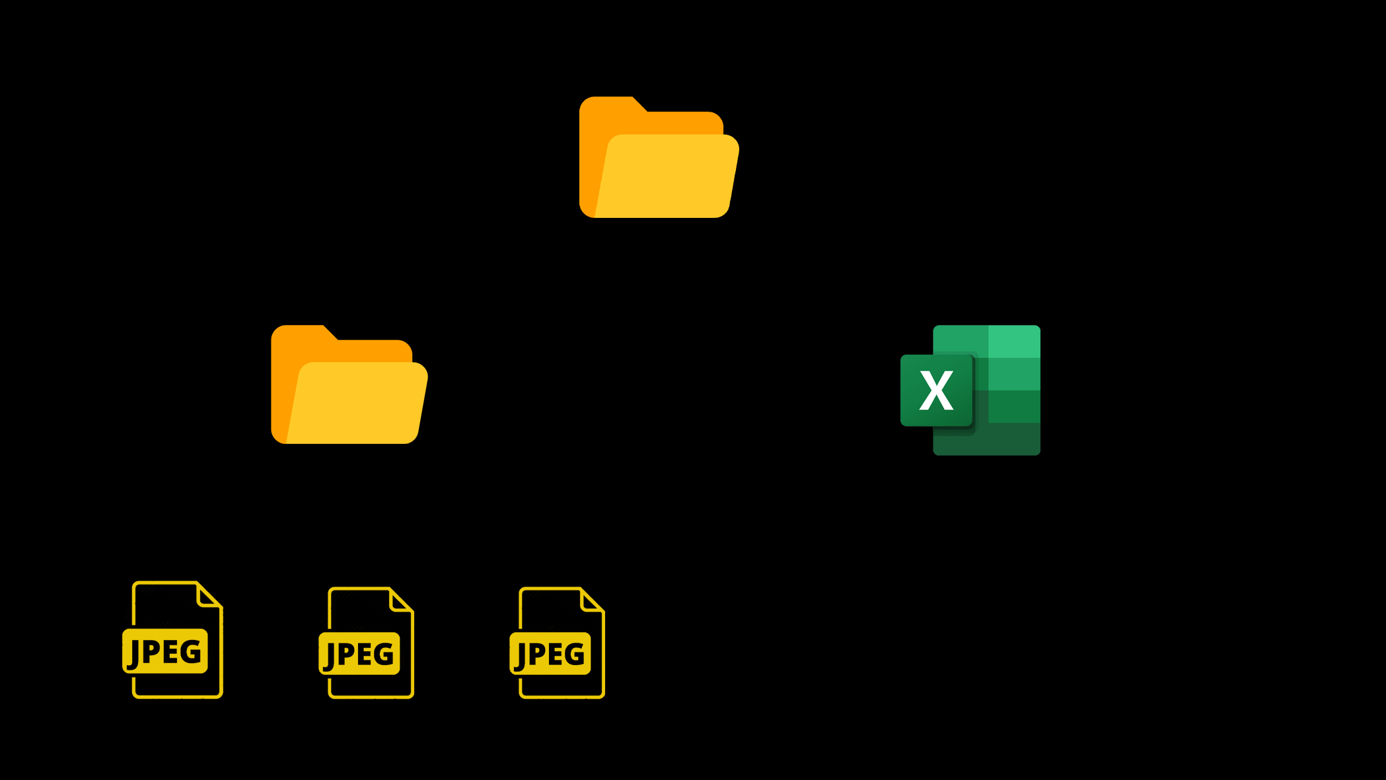
Database Design
d
F A C E R E C O G N I T I O N
Attendance with face recognition
23
Algorithm Used
The program follows the algorithm of
Image Data
Attendance Data
Voila-Jones algorithm and ,The comparison of encodings is done using linear SVM
IImage Data

Slide 24
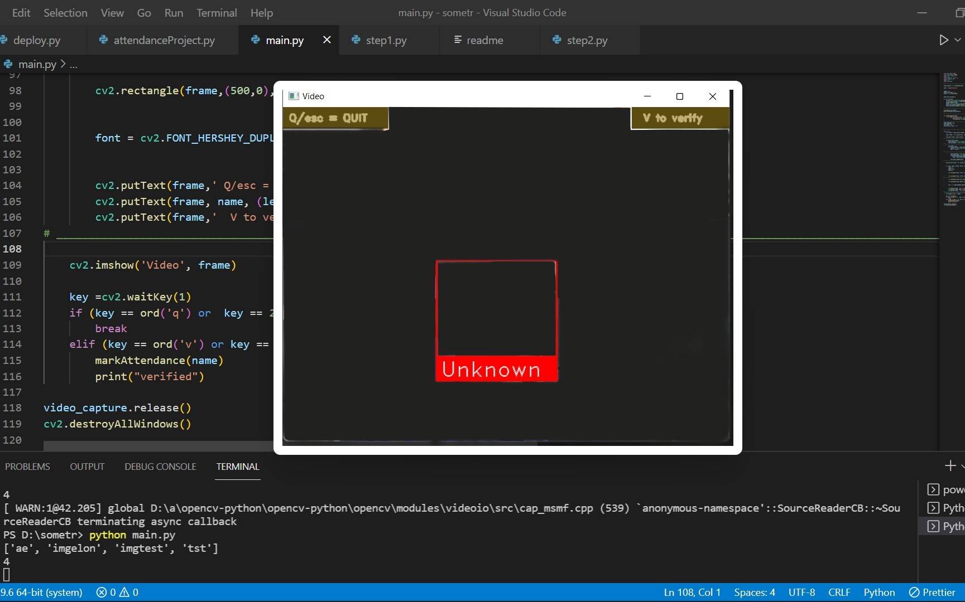
Output
Interface
24

Slide 25
E
F A C E
R E C O G N I T I O N
n
D

